Slide 1


Personal Information Security Protection
in a Modern Era

Slide 2
Introduction
Agenda
Intro to Big Data
Personal Data Protections
  Personal Email Security.
  Personal Messaging Security.
  Internet Browsing Security.
  Internet Password Security.
  Internet Tracker Security.
  A Quick Note on Socials.
  Offline Data Protections.
Easy Safeguards
Q + A

Slide 3

Intro to Big Data
What IS Big Data:
Notes:
Big Data – representation of some of the things that go into the concept of big data, when it comes to the internet and information available on the internet, with the right sets of information / data about you, they can assemble a picture to learn more about you as a consumer. Beyond the surface company, these organizations have trackers and collectors to gather information about you to build a profile about you that can then be sold for targeted marketing and monetizing information to target advertising and increase sales.
WHY:
The line between public and private data is continually degrading.
PRIVACY && Security – They go hand-in-hand.
If they have this data, attackers will eventually be able to get this data.
REMEMBER: IF you are not paying for a product, then you and your data are the product.

Slide 4
Intro to Big Data – What they want
Web Metrics:
Website Visits.
Web Page View Length
Web Page interactions // Clicks // Redirects
Web History
Phone Metrics:
Call Records
Recipient
Length
Time of day
Location call was made from
SMS & MMS Contents
Photos captured on your phone
Facial Recognition Data
EXIF Metadata – e.g. type of device, geolocation data, time of day, date, etc.
Video Metrics (Netflix, Hulu, Youtube, etc.):
How long did you watch?
Did you finish the video?
Did you subscribe?
ISP Data:
What do you download
What sites do you visit
What do you listen to
What are you reading
When are you online
GPS Data:
Where do you drive
How long do you drive
By association, they can determine if you’re speeding
Where you spend most of your time.
Other nearby devices – e.g. people.
Your location at any given moment
Notes:
Pieces of the puzzle – what they want to know, this is the information that companies and websites, internet service providers, cell phone provider – all gathering this information to help market products, make addictive environments, make predictions of your behaviors, triggers, and habits. (who you would be inclined to vote for, predicting future purchases)

Slide 5
Intro to Big Data – What they want
Online Shopping:
What you view.
What you buy.
When you buy.
How often you buy.
Average price of the items purchased.
Items Like This: Interactions.
Where you ship things to.
Your preferred payment methods.
Combinations of purchases.
Rewards Cards
Commercial Email:
Quantity of email received
Email interactions.
Contents of email messages.
Keyword searches through your emails.
Common Senders and Recipients
Times active in email.
Marketing emails you click on.
Ads that are relevant and interacted with.
Social Media:
Your Friends.
Photos and related EXIF data.
Your interactions on the site
What you click on.
What ads interest you.
Pages you’ve liked.
Your email
Your private messages
Notes:
EXIF data
Adjust meta data in EXIF to modify the date, time and location the photo was taken

Slide 6
Intro to Big Data – What they want
Health Information:
Known health issues.
Doctors visited.
HIPAA Data is full of personally identifiable information that any hacker could use to pose as you.
Bank Information:
Vendors you shop at.
Credit card information
Bank Account information and history.
Loan information, lienholder, and history.
SSN’s.
Employment History:
Past employers
Past job titles
Past cities worked in.
Likely salary range.
Contact information for past employers.
Life History:
Previous towns lived in.
Types of cars you drove
Schools attended
Family history

Slide 7





Intro to Big Data – Who wants it
KBA (Knowledge Based Authentication.)
COVID-19 Unemployment Fraud
Social Engineering Friend Groups to gather more targets.
Location-Based Policing
Digital Evidence Gathering
Nefarious Hackers
Law Enforcement
(Kyle on a Thursday)
Targeted Mailers.
Rewards Program Coupons on things you might want.
Store analytics: Placement of items nearby one another.
Show you what you want before you know you want it.
Targeted Advertising
Vendors (Online and Retail)
Notes:
Who?
Hackers – use you information to bypass security tools to get your password, or target you with social engineering to get you to click on things you shouldn’t,
Law Enforcement - with location based policing – riots, murders, school shootings
Vendors want to sell you things and use targeted mailers, coupons, rewards, store item placement/end caps
Targeted Advertising – show you what you want before you know you want it

Slide 8

Intro to Big Data
Putting it all together.
Man Arrested for Google GPS Data.
Diapers and Beer Syndrome.
IRS Get-Transcript Service
How China Uses Facial Recognition to Control Human Behavior
Capitol Rioters Arrests Made after Warrant for GPS Data.
Notes:
Man on bike ride near murder scene arrested
Diapers and Beer – major retailer in US using analytics from purchases, many were buying diapers and beer at the same time – collating all of this information they discovered through this that these are new fathers sent to the store to pick up diapers and since they are going out less with a new baby, they were purchasing alcoholic beverages at the same time at the store, so they changed store placement and boosted sales
Social Engineers used tactics to answer security questions to get tax transcripts to use old data to submit latest years tax return
Social currency system –
Same as bicyclist

Slide 9
Personal Data Protections
Personal Data Protections
Personal Emails
Personal Messages
  SMS // MMS
Internet Browsing
  History
  Cookies // Trackers
  Form Data // Passwords
  Home // Public Internet Protections.
Personally Identifiable Information
  Knowledge Based Authentication
  Social Media (Messages, Pages, Posts).
Notes:
How do you protect yourself?
https://support.google.com/accounts/answer/3024190?hl=en
https://www.facebook.com/help/212802592074644

Slide 10



Personal Data Protections
Personal Email Security
Free email services scrape email contents for information to help them advertise to you.
  Message Times, Message Contents, Message Recipients, Contacts in your Mailbox, Message lengths, message attachments, etc.
Think of using a paid subscription:
Pros:
  All contents are fully encrypted at rest and in transit -- E.G. No snooping on contents.
  Feel more secure in sending // storing personal information.
  Tutanota and ProtonMail Subscriptions contain other applications similar to Google – Calendar, Drive, and VPN.
Cons:
  Sometimes run into non-deliverable emails to corporate entities.
  $$$$.

Slide 11
Personal Data Protections
Personal Email Security Quick Tips:
Maintain Multiple Inboxes:
  Paid and Secure Inbox for personal correspondence and use.
  Free and Open Inbox for giving out for rewards programs, marketing emails, etc.
    Cub Rewards, Speedy Rewards, Walgreens, CVS, Caribou, Starbucks, O’Reilly’s Rewards, etc.
  Bonus Tip: Toy with them by giving it a fun name like:
      SendSpamHere@gmail.com
      I-dont-want-your-emails@yahoo.com
      Stop-wasting-my-time@outlook.com
      This-is-my-junk-box@gmail.com
      Im-not-reading-these@aol.com

Slide 12
Personal Data Protections
Personal Messaging Security
SMS (Short Messaging Service) – Standard Text Message Format
  Unencrypted
  Easy to intercept
  Collected by cellular carriers and can be provided as part of data discovery with a warrant.
  Scooped up and analyzed by the NSA.
MMS (Multimedia Messaging Service) – Standard Video // Photo Message.
  Unencrypted
  Easy to intercept
  Collected by cellular carriers and can be provided as part of data discovery with a warrant.
  Scooped up and analyzed by the NSA.

Slide 13

Personal Data Protections
Best Messaging Alternative
PROS:
Free and Open Source.
Encrypted messaging between other Signal users.
Encrypted phone calls between other Signal users (Signal Call).
Easy to set up.
Able to manage SMS and MMS messages as well as Encrypted Signal Messages.
Easy for friends to find each other
CONS:
Not as slick of a user interface as some standard messaging apps (but it’s always improving).
Loss of functionality from standard messaging applications – iMessage for iPhone users, Google Messaging for Android users.
Open default privacy options: easy for people to find you – uses your phone number as your ID.

Slide 14


Personal Data Protections
Other Messaging Alternatives
Telegram
PROS:
Lots of privacy options.
Uses a unique identifier rather than your phone number.
Very secure encryption.
CONS:
More difficult to set up than Signal.
$$$$ ($2.99 One-Time-Purchase).
PROS:
Free
Fast speeds with video calls.
Secure encryption.
Easy to find friends
Easy to hide yourself
Secret Chats.
CONS:
Unknown Monetization Scheme.
  Likely ties to Social Media Revenue Streams

Slide 15
Personal Data Protections
Internet Browsing
Internet Service Providers (ISP’s):
  Gather Browsing Data and sell it to advertisers.
  Trace your IP address for suspicious activities online.
  Keep a record of sites you visit that can be provided to law enforcement or other agencies.
Website Providers:
  Use Cookies and Trackers to follow what you do on their sites.
  Trace your activities after leaving their site.
  Use this data to customize ads and create a profile about you as a user.
Form Data // Passwords:
  Browsers can save your login information and form information (Address, bank cards, etc.)
  DON’T DO IT! Hackers can collect these EXTREMELY easily.
Home || Public Internet Protections:
  Defaults are dangerous.
  Protect yourself on Public Networks.

Slide 16

Personal Data Protections
Get a REPUTABLE VPN:
Solve ISP Data Gathering and Unsafe Public WiFi.
Internet Packets: The backbone of the internet.
Analogy: Sending War and Peace on Postcards.
  Every postcard has the Sender, the Recipient, and a portion of
  the data being sent.
  These postcards are then reassembled by the recipient.
  The Mailman can read them, and anyone who knows where to look
  for the postcards can also read them.
  A single postcard does not contain the full story of what is being sent,
  but it might give a good idea to the snooper what the interaction between the two parties is.
A VPN is an Envelope for your postcards.
  The same data is in transit, but now the only person who is reading the contents of the postcard is yourself as the sender and the recipient.
  No one in the middle can see where the card is coming from or its final destination.
  Anonymizes your traffic and allows you to browse freely without having your data collected and sold to advertisers.

Slide 17



Personal Data Protections
Reputable Options
BUY A SUBSCRIPTION!
They do not store web logs.
They encrypt your Internet Traffic
The offer Cross-Platform Support.
  Windows // MacOS // Android // iOS // Linux
They anonymize and privatize your browsing.
Creates a safe tunnel from which to use Public WiFi.
  Public WiFi is notorious for being unsafe as anyone else on the same network can view what your computer is interacting with.

Slide 18
Personal Data Protections
Web Password Security
Web browsers like Mozilla, Google Chrome, Microsoft Edge, Safari, and Internet Explorer give you the option to save your passwords and form data in the browser.
DON’T DO IT!
Hackers can easily extract this data from your browser and steal your passwords, addresses, credit card information, etc.
If your passwords are similar, or the same, across websites; a single breached password can compromise your entire online identity.

Slide 19
Personal Data Protections
Password Security – Setting Strong Passwords
Set Strong Passwords:
  Pearl1980 == BAD
  P3ArlintheD0GH@use#1980 == OK.
  Mydog’snameisPearlandsheisAWESOME!1980 == Better.
  OctopusBatteriesPancakesOrangesTesla!1980@ == BEST.
In many cases, a long password will outrank a confusing password.
  This has to do with how passwords are stolen and cracked.
admin::N46iSNekpT:08ca45b7d7ea58ee:88dcbe4446168966a153a0064958dac6:5c7830315c7830310000000000000b45c67103d07d7b95acd12ffa11230e0000000052920b85f78d013c31cdb3b92f5d765c783030

Slide 20
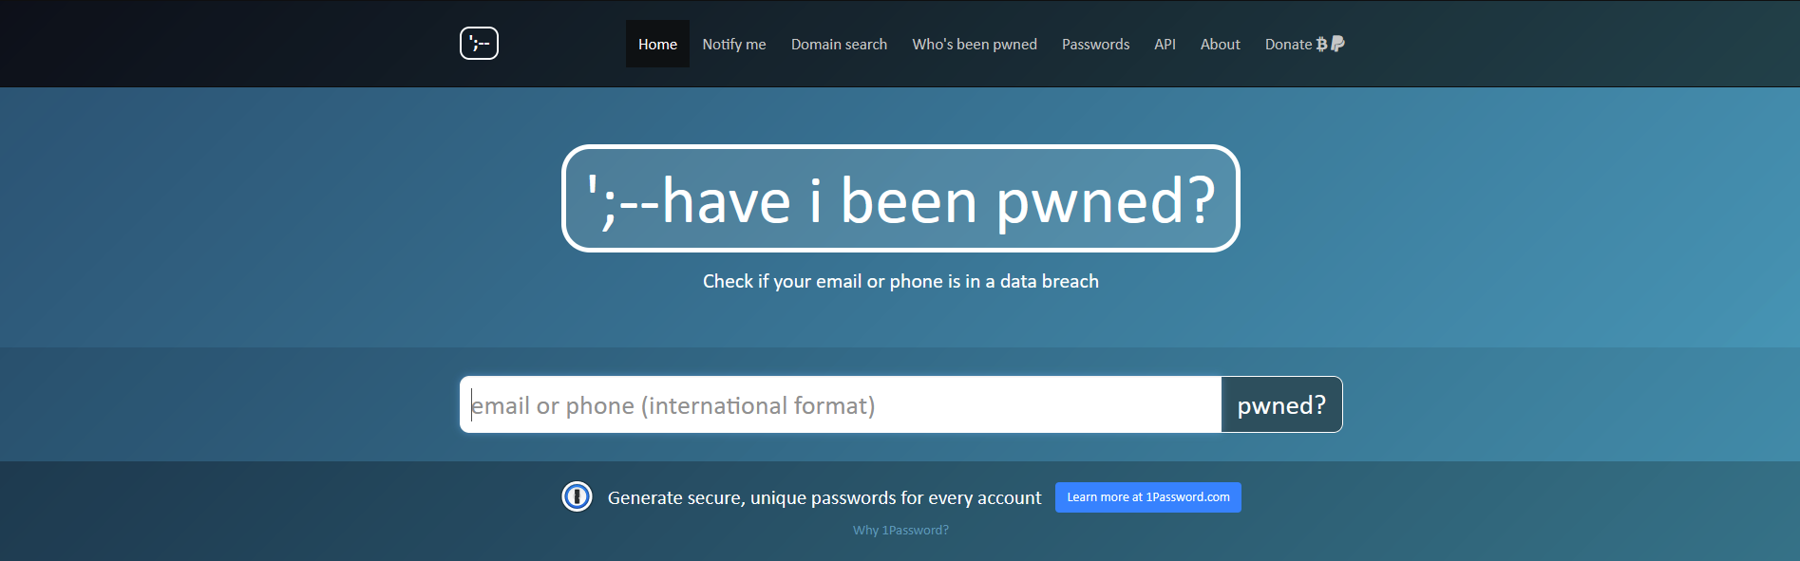
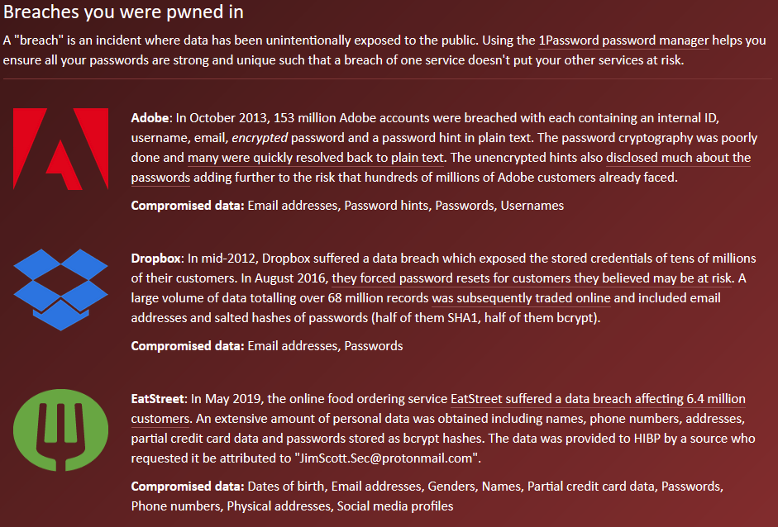
Personal Data Protections
Password Protection Step 1:
How to tell if your passwords have been breached:
If you have been part of a breach:
  Proceed to Password Protection Step 2: Use a Password Manager.
If you have not been part of a breach:
  Proceed to Password Protection Step 2: Use a Password Manager.
Source: https://haveibeenpwned.com
Notes:
Attackers will take these breached passwords, and attempt to authenticate with other websites using the same Email:Password combination.
This is why it is important to use

Slide 21

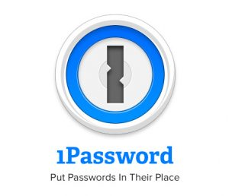



Personal Data Protections
Password Protection Step 2:
Use a Password Manager.
PROS:
Have unique passwords for every site.
Generate random passwords that are harder to guess than:
  Pearl1980.
Autofill features that don’t save to the browser.
Encrypted Vaults.
CONS:
All the eggs are in one basket.
  Have a good key.
$$$$
Can be tedious to set up
Notes:
Ensure you select a STRONG password for these vaults.
Using a short sentence or random combinations of words is better and more memorable in time than a single word.
ElephantsSwimmingInTheIndianOcean.1989
ThQueenOfEnglandDrivesAJeepWrangler.2945

Slide 22



Personal Data Protections
Password Protection Step 3:
Use Multi-Factor for Password Access.
BONUS TIP: Using MFA on any site where it’s available adds an additional layer of security to any online platform. (Many of the applications above can integrate with MFA on other sites).
Notes:
MFA – Prevents Credential stuffing. Better than the SMS based MFA available via most web applications.

Slide 23

Personal Data Protections
Cookies and Trackers.
What is a cookie?
Many Websites…
  Use Cookies and Trackers to follow what you do on their sites.
  Trace your activities after leaving their site.
  Use this data to customize ads and create a profile about you as a user.
With a few simple browser extensions, you can block these cookies and stop them from tracking your activities.
Notes:
Cookies are text files with small pieces of data — like a username and password — that are used to identify your computer as you use a computer network.
What does website cookies do?
A cookie is a piece of data from a website that is stored within a web browser that the website can retrieve at a later time. Cookies are used to tell the server that users have returned to a particular website.

Slide 24



Personal Data Protections
Useful Browser Extensions:
Privacy Badger: Cookie and Tracker Blocker and Remover.
Ghostery: Cookie and Tracker Blocker and Remover with a built-in ad-block feature.
uBlock Origin: Open-Source ad-blocker with a few privacy features.
Ghostery and Privacy Badger remove and block cookies.
uBlock Origin blocks some cookies, but is mainly focused on stopping advertisements.

Slide 25
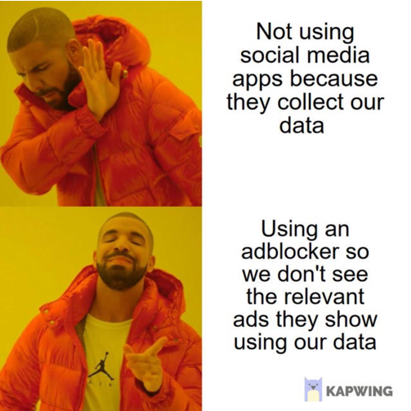
Personal Data Protections
ONCE YOU POST SOMETHING ON SOCIAL MEDIA YOU NO LONGER HAVE CONTROL OVER THE CONTENT
Images, addresses, phone numbers, names, family members, etc. Once it’s posted it is accessible to anyone around the globe to scrape, view, and use against you.
Remember Knowledge Based Authentications: Hackers will use your profiles to learn about you, learn answers to the questions, and try to pose as you to get into your accounts.
QUICK TIPS:
  Be a good employee, don’t post your ID Card on Social Media – even if you’re excited about that new job. (It’s a popular thing on LinkedIN… Just don’t do it.)
  Remember, social media sites collect your data and sell it to advertisers. Don’t share anything on there that you don’t want added to an advertising profile about yourself.
  Spend the time, check the privacy settings, and turn off anything you’re not comfortable with.

Slide 26
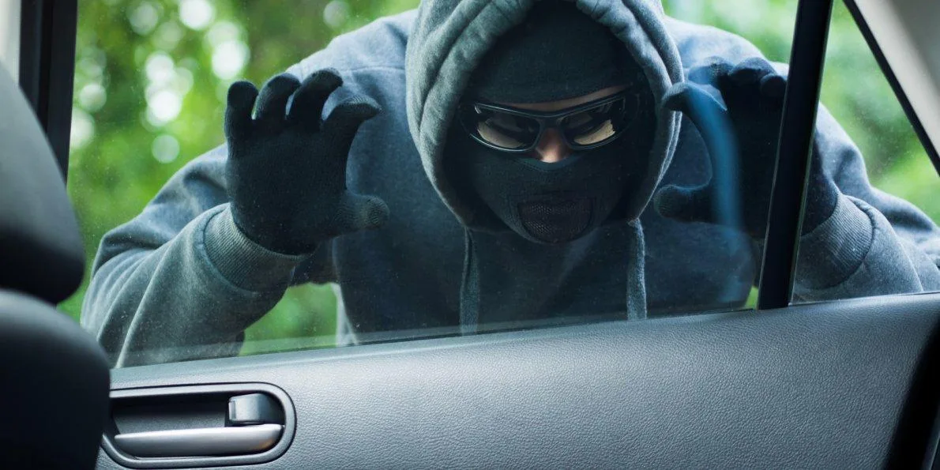
Some Easy Safeguards
Offline Data Protections
Be aware of how your data is exposed
  Shred sensitive documents before disposing of them
  Remove labels from medications before discarding
  If able, put trash out the day of collection to prevent dumpster diving
  Mail payments from a secure mailbox or put out close to pickup time, if able.
Avoid leaving mail, or other documents with your name or address on them in plain sight (ex: back seat or console of your car)
QUICK NOTE:
  Identity theft is rarely due to a single breach. Identity thieves, hackers, and other malevolent actors are professionals at piecing together disparate sources of information to create a full picture from which they can pull off a successful crime.
Notes:
https://support.google.com/accounts/answer/3024190?hl=en
https://www.facebook.com/help/212802592074644

Slide 27
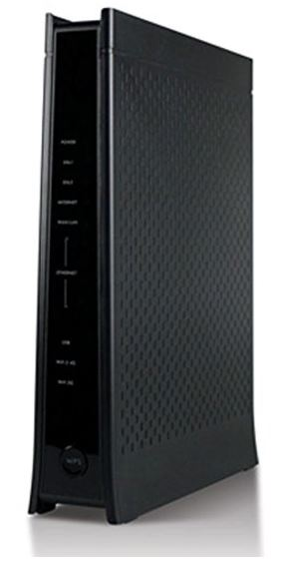
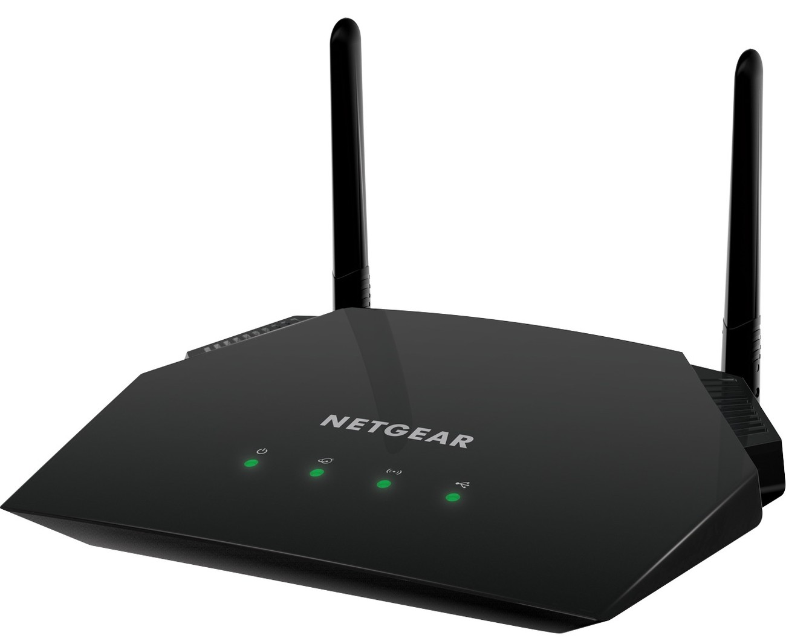
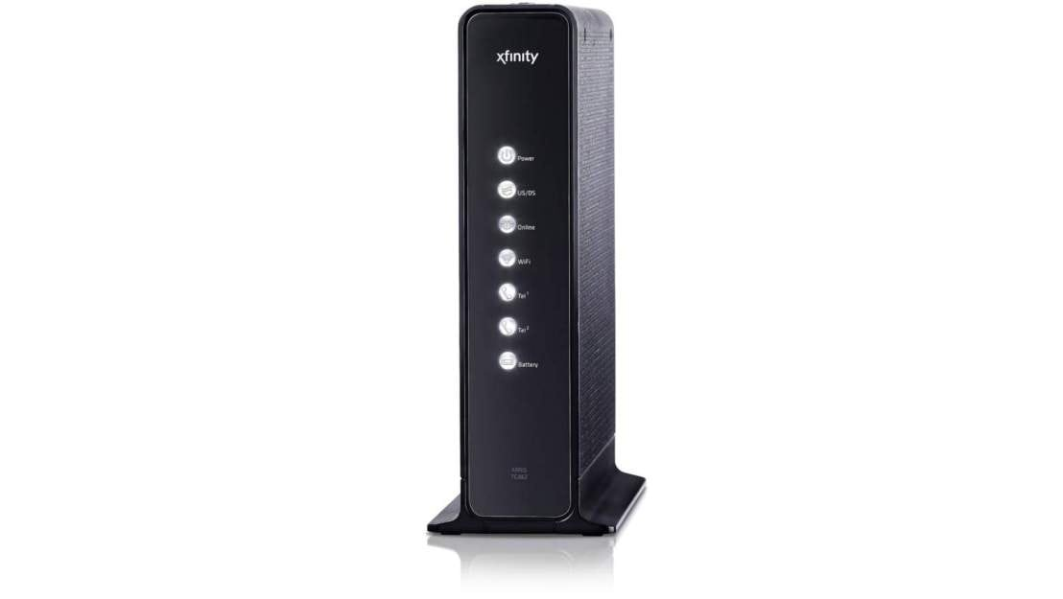
Some Easy Safeguards
Some Easy Safeguards.
Part 1: DEFAULTS ARE DANGEROUS
All home routers and modems ship with a DEFAULT username and password
Your cellphone DEFAULT pin for your voicemail is the last four digits of your phone number.
The DEFAULT customer pin for your cell-service provider is the last four digits of the account-holders social security number.
Hackers can easily find default credentials or crack the codes on how they are generated. ALWAYS change them.

Slide 28

Some Easy Safeguards
Cellular Number
Use a random pin for your account information and store the PIN in your password manager
Avoid using your (real) mobile number as an identifier for services.
Think about using a cellular masking service like Burner ($46 / year) or Google Voice (Free - Less Private) to hide your true phone number when making calls.

Slide 29




Protecting Your Credit
Protecting your Credit
Store your social security card in a safe/secure place – Don’t carry with you.
Freeze Credit (Experian, TransUnion, Equifax, Innovis)
File taxes early.
Check Credit Report Annually
  You are entitled to get a free copy of your credit report from each of the credit reporting agencies at AnnualCreditReport.com. Review it carefully for inaccurate, incomplete or unfamiliar information.
Review Annual Social Security Earnings Statement
Mobile alerts from Bank/Credit cards on each transaction

Slide 30
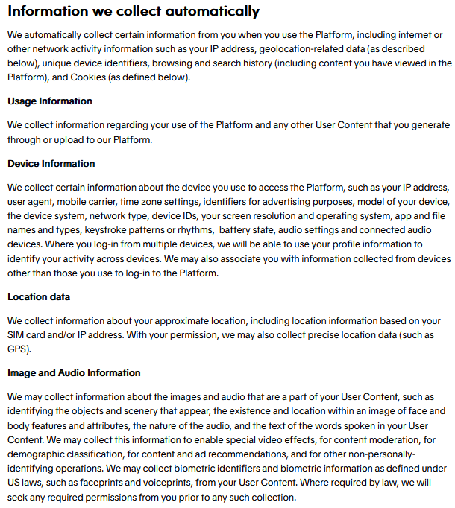

Why TikTok is in the news

Slide 31
Checklist Part I
Freeze your credit at all four major credit bureaus:
  https://www.nerdwallet.com/article/finance/how-to-freeze-credit
STOP SAVING YOUR PASSWORDS IN YOUR BROWSER: Get a Password Manager:
  https://LastPass.com
  https://1password.com
  https://Dashlane.com
  https://keepersecurity.com
Consider using Multi-Factor Authentication wherever possible
  https://okta.com
  Microsoft Authenticator Application
  Google Authenticator Application
  Last Pass Authenticator Application
Consider using Cookie Deleters, Tracking Blockers, and Ad Blockers on your browser:
  https://ublockorigin.com
  https://ghostery.com
  https://privacybadger.org

Slide 32
Checklist Part II
Download Your Google // Social Media Data and determine if you are happy with what they know about you.
  https://support.google.com/accounts/answer/3024190?hl=en
  https://www.facebook.com/help/212802592074644
Test out a free account on Protonmail or Tutanota and consider purchasing a subscription.
  https://www.protonmail.com
  https://www.tutanota.com
Use a free email account for all your marketing emails.
  https://gmail.com
  https://yahoo.com
  https://aol.com
  https://outlook.com
Consider switching to Signal for messaging and encourage your contacts to do the same:
  https://signal.org/en/
    Other alternatives are Threema and Telegram
      https://threema.ch
      https://telegram.org
Sign up for a reputable VPN Service
  https://protonvpn.com
  https://nordvpn.com
  https://www.privateinternetaccess.com/
Check out if your email has been part of any breaches:
  https://haveibeenpwned.com

Slide 33
Checklist Part III
Check out the privacy settings on your social media and determine if you’re content with the amount of information you are giving to the platform.
  https://www.facebook.com/help/325807937506242
  https://help.twitter.com/en/managing-your-account/new-account-settings
  https://help.instagram.com/196883487377501
  https://support.snapchat.com/en-US/a/privacy-settings2
  https://support.tiktok.com/en/account-and-privacy/account-privacy-settings
  https://www.linkedin.com/help/linkedin/answer/92055/understanding-your-privacy-settings?lang=en
  https://www.reddit.com/settings/privacy
Shred any old documents that contain personal information.
  https://shredrightnow.com/events/category/shredevents/
  https://twincitiesonthecheap.com/your-guide-to-free-paper-shredding-in-the-twin-cities/
  Check your City Website for Local Shredding Events.
Change Default passwords on your router/modem/internet access point at home:
  Going to a web browser and typing 192.168.1.1 will typically get you to the administrative panel of your home internet connection.
Consider giving out fake phone numbers for rewards program, or a fake phone number that you keep in your password manager.

