Slide 1
Social Engineering
phishing, smishing, and other trickery

Slide 2
Agenda
Introduction
Smishing (SMS Phishing)
eBay Scam
Panera Bread
Norton LifeLock
Phishing

Slide 3
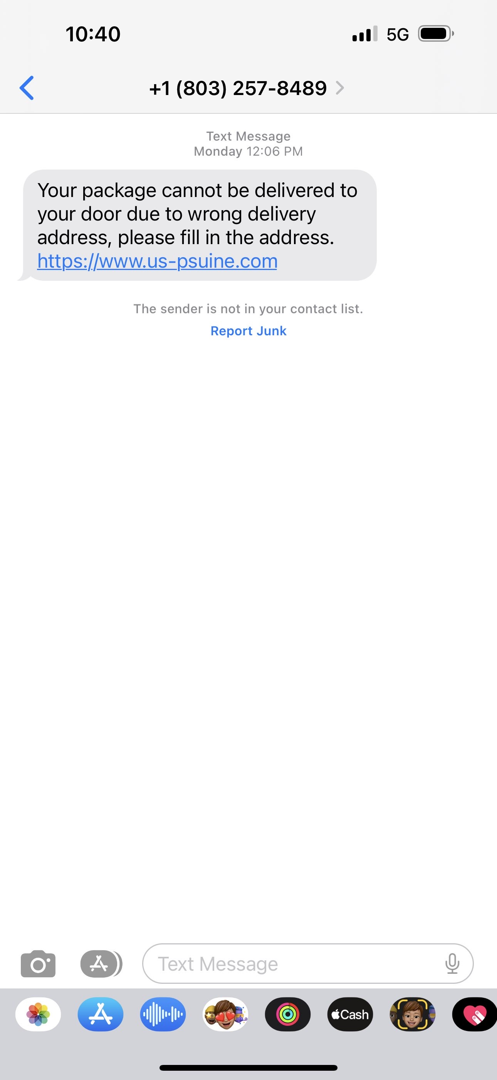
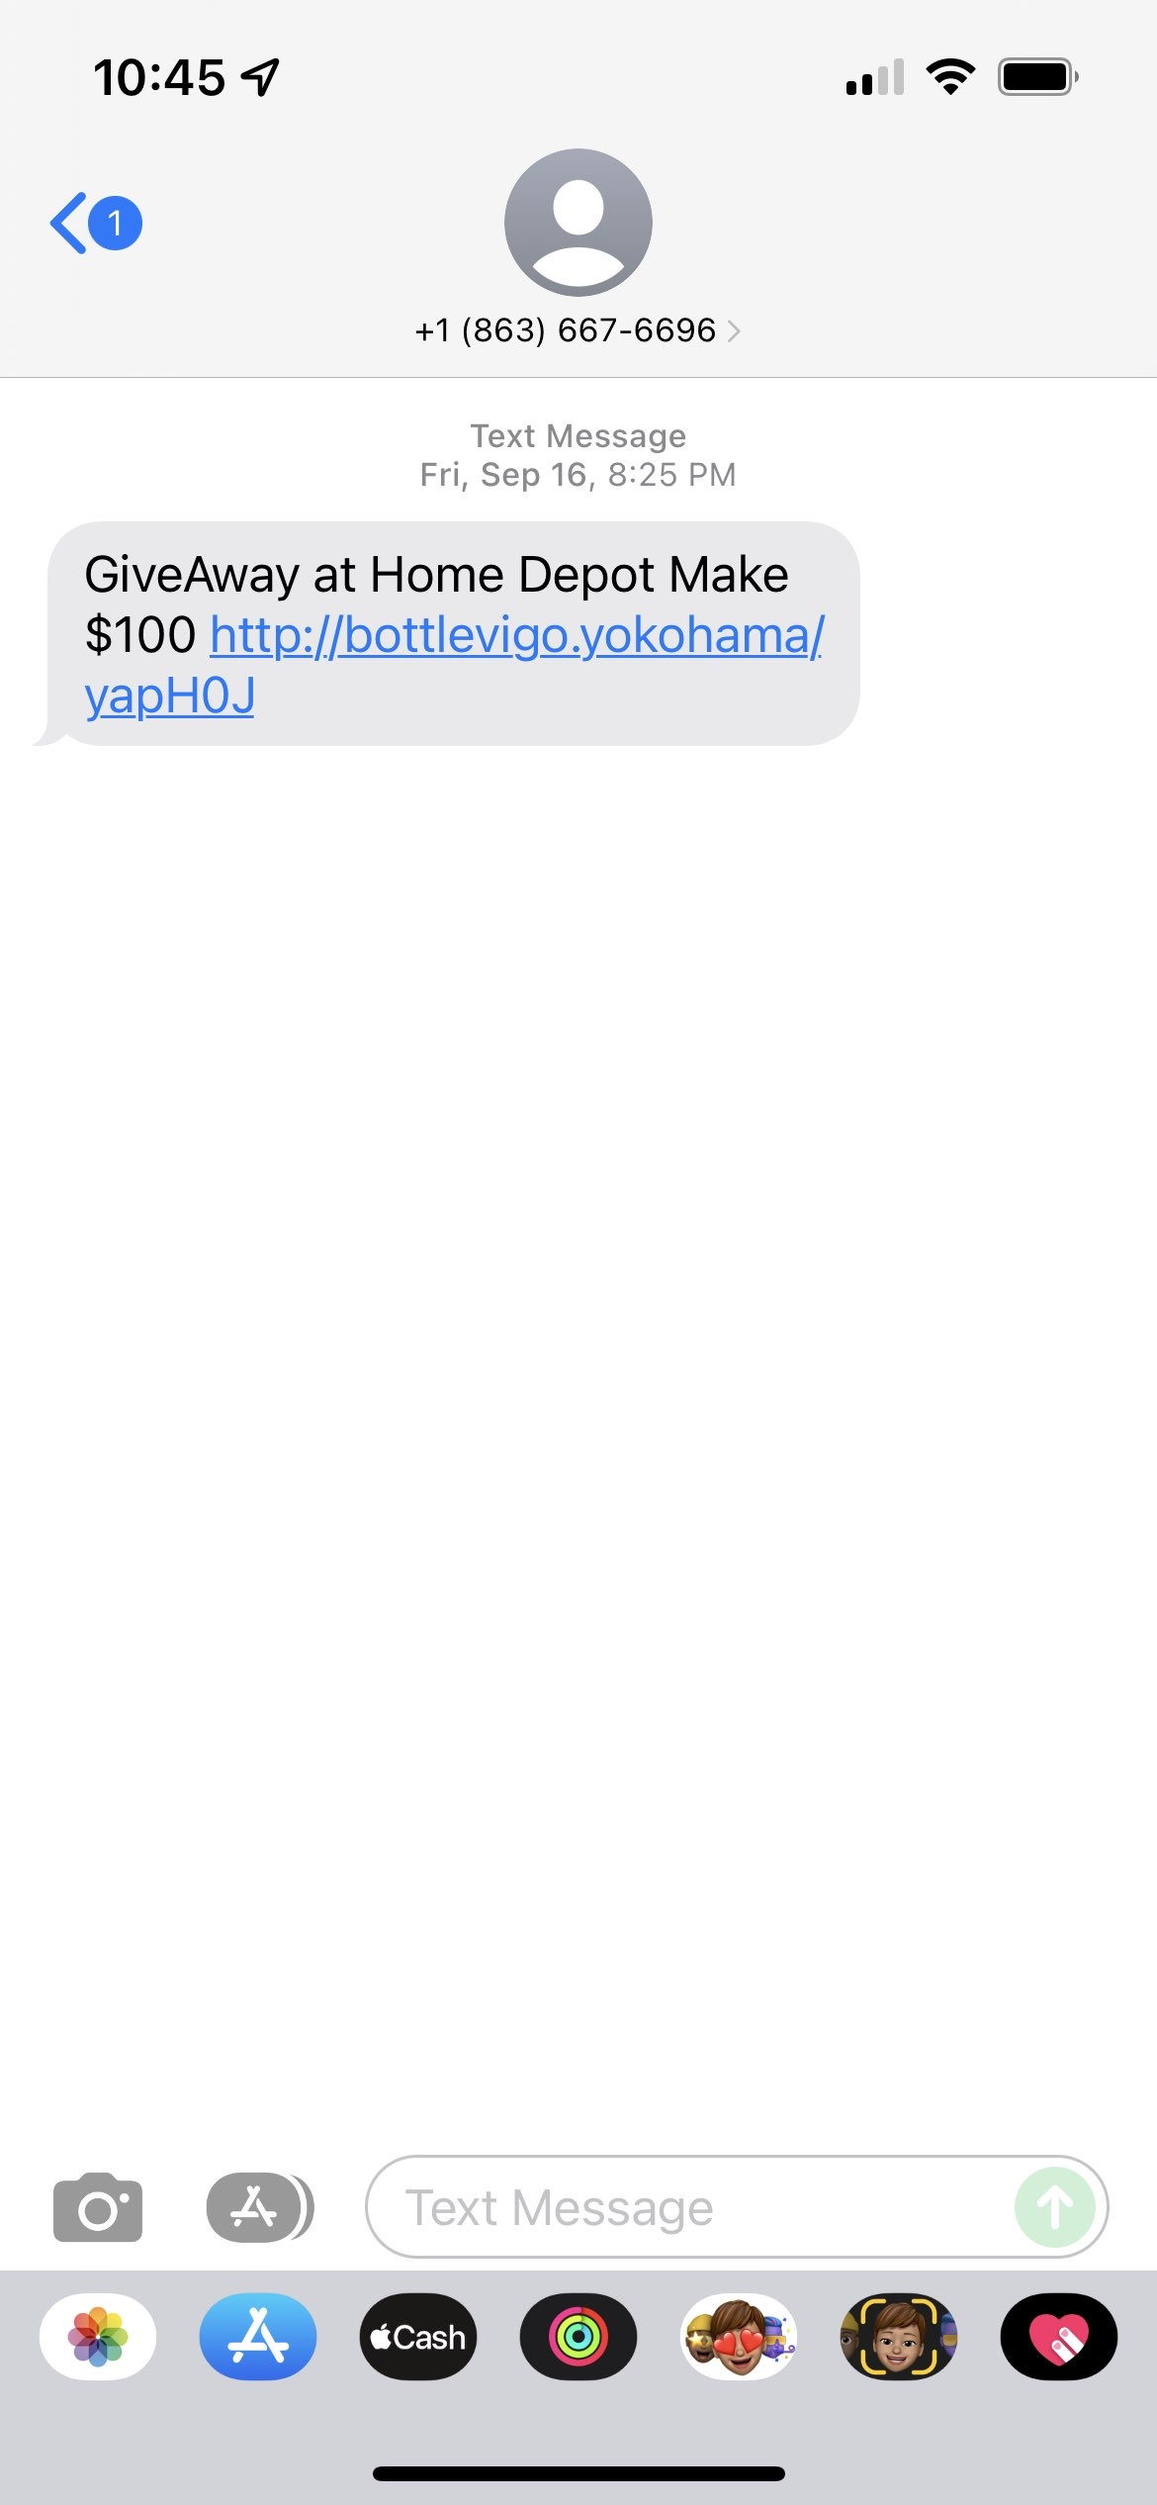
Smishing (SMS Phishing)

Slide 4
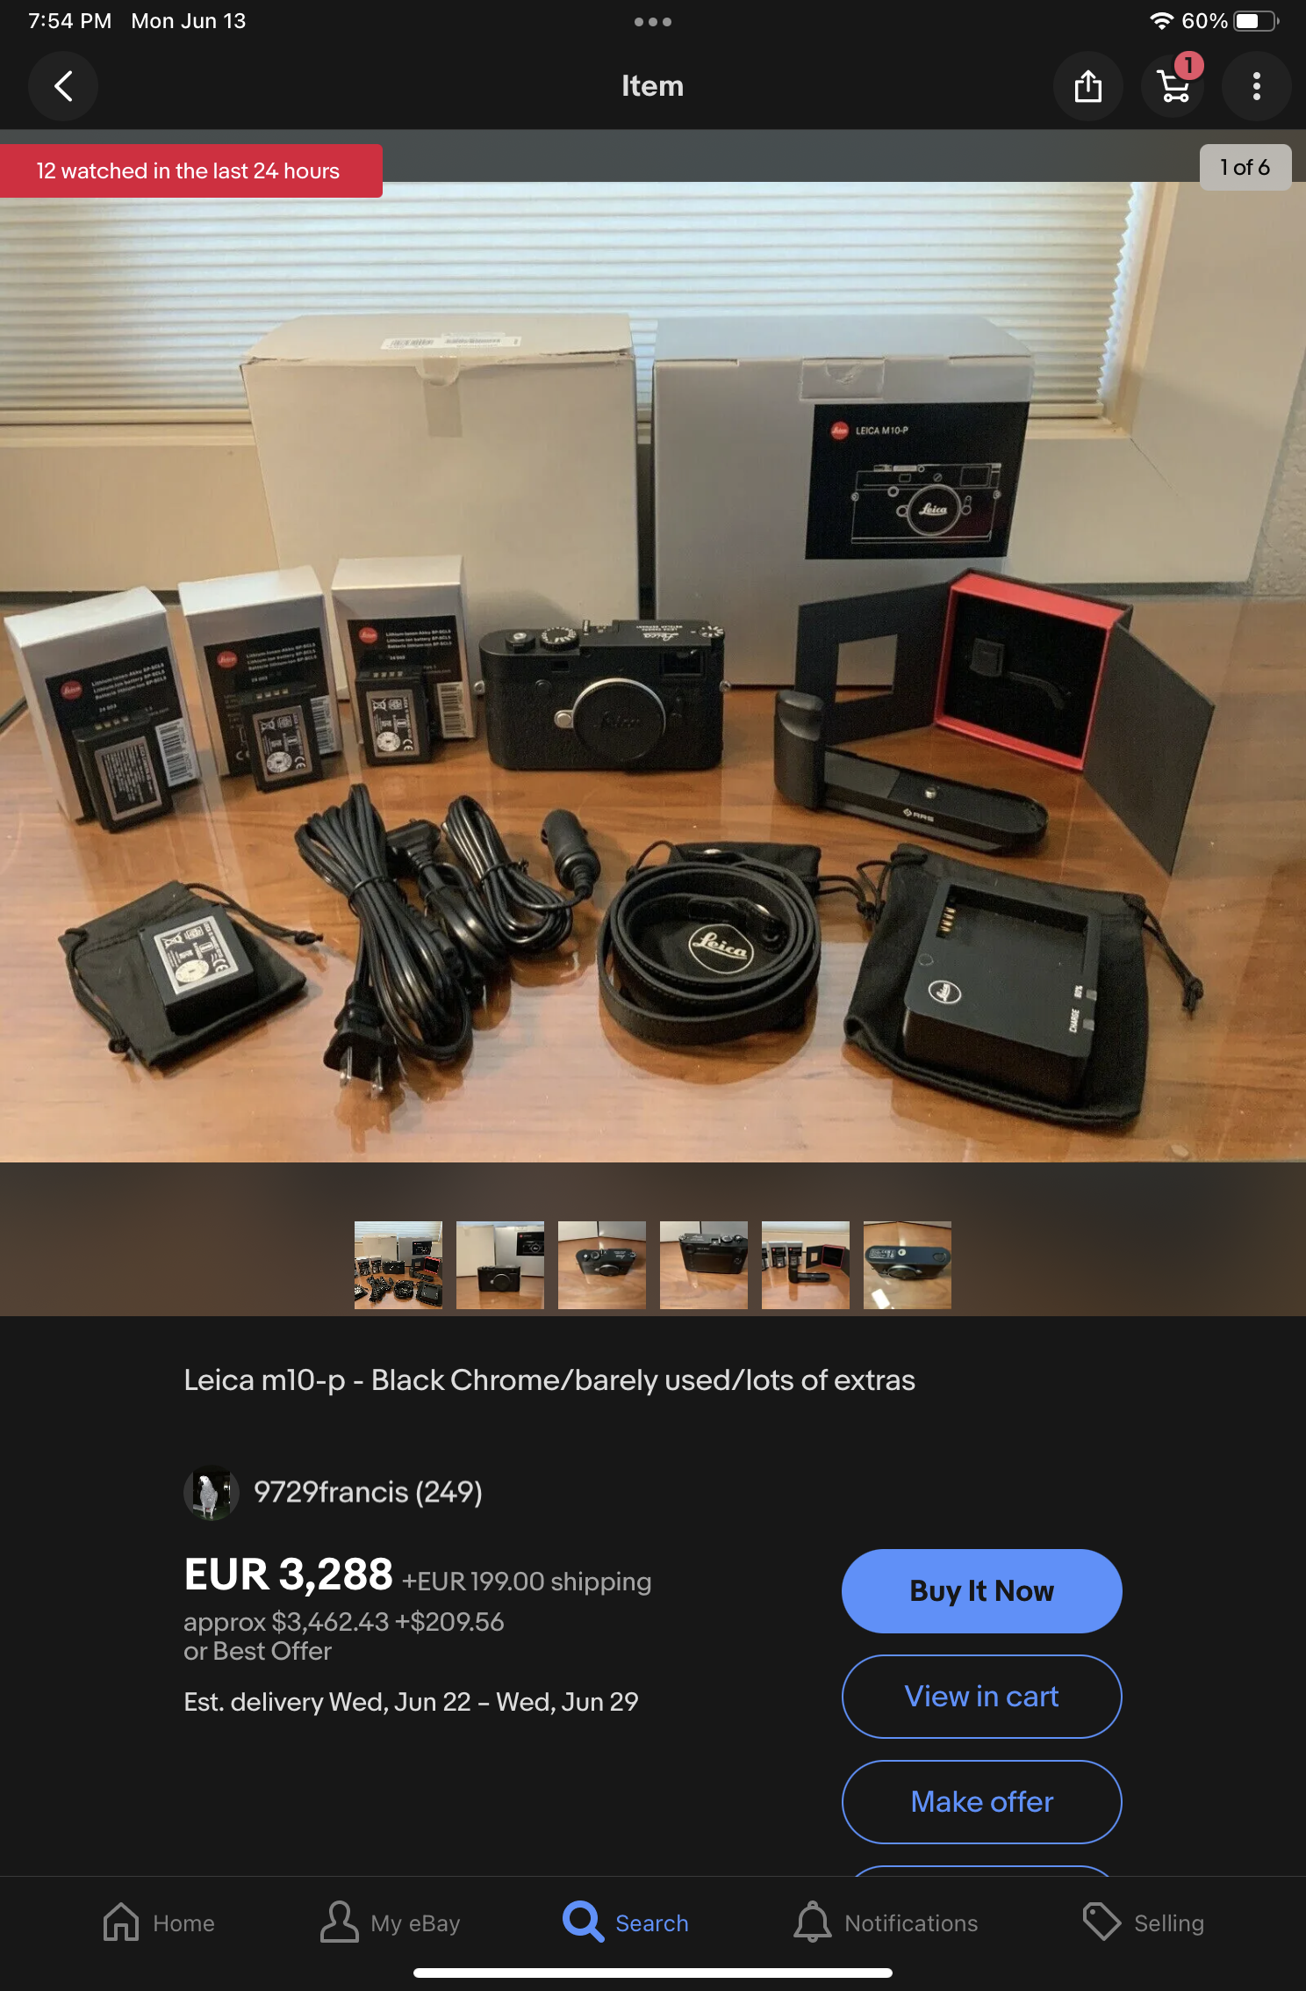
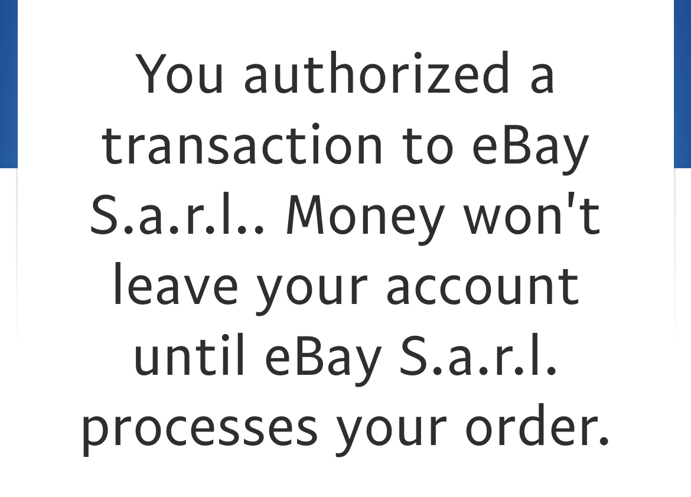
eBay Scam

Slide 5
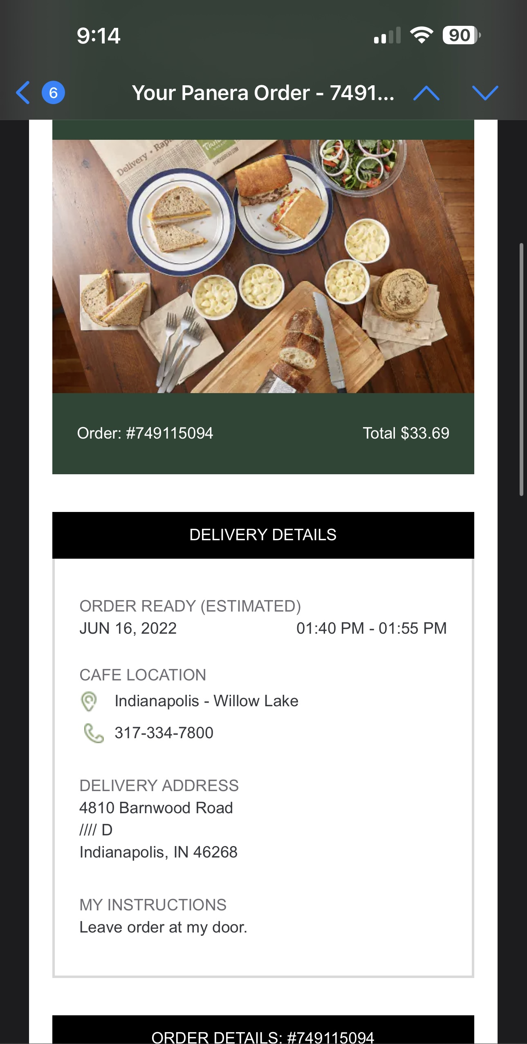
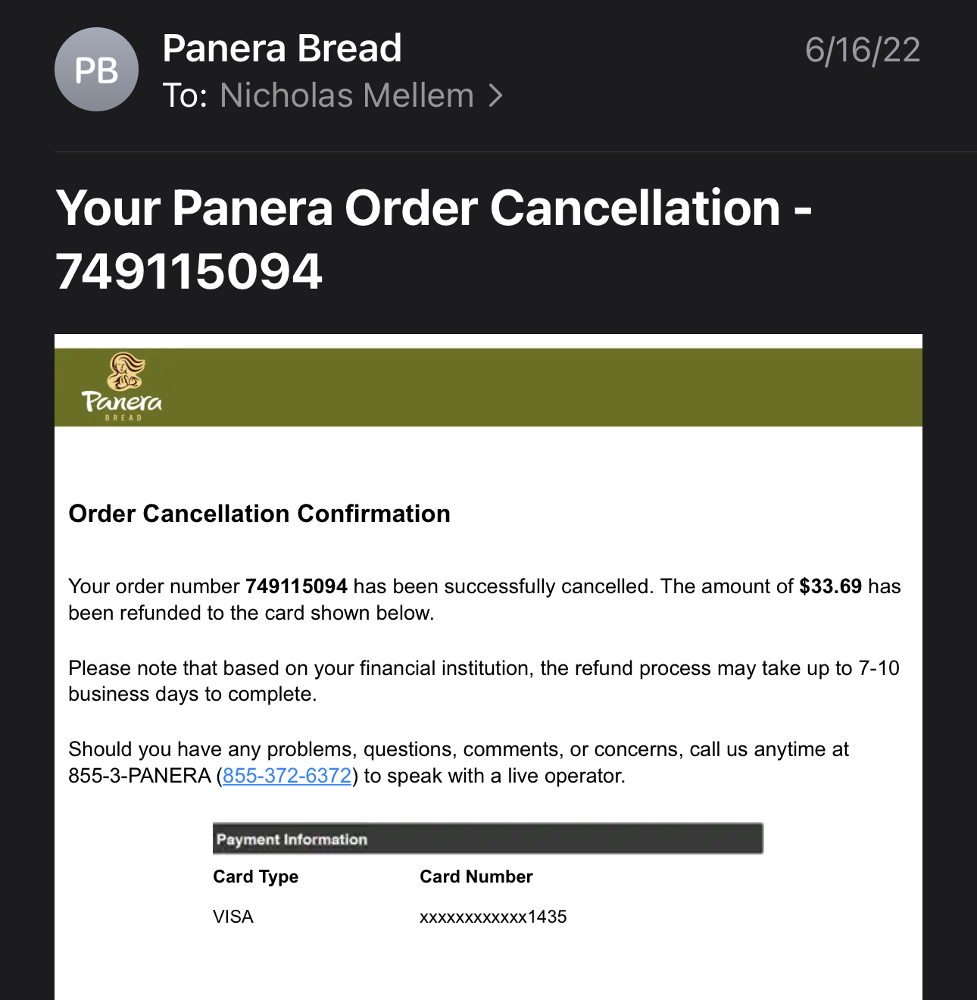
Panera Bread

Slide 6
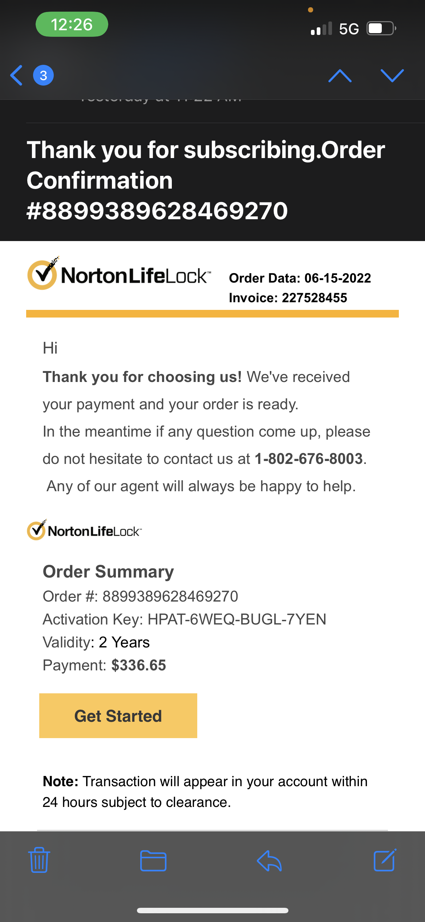
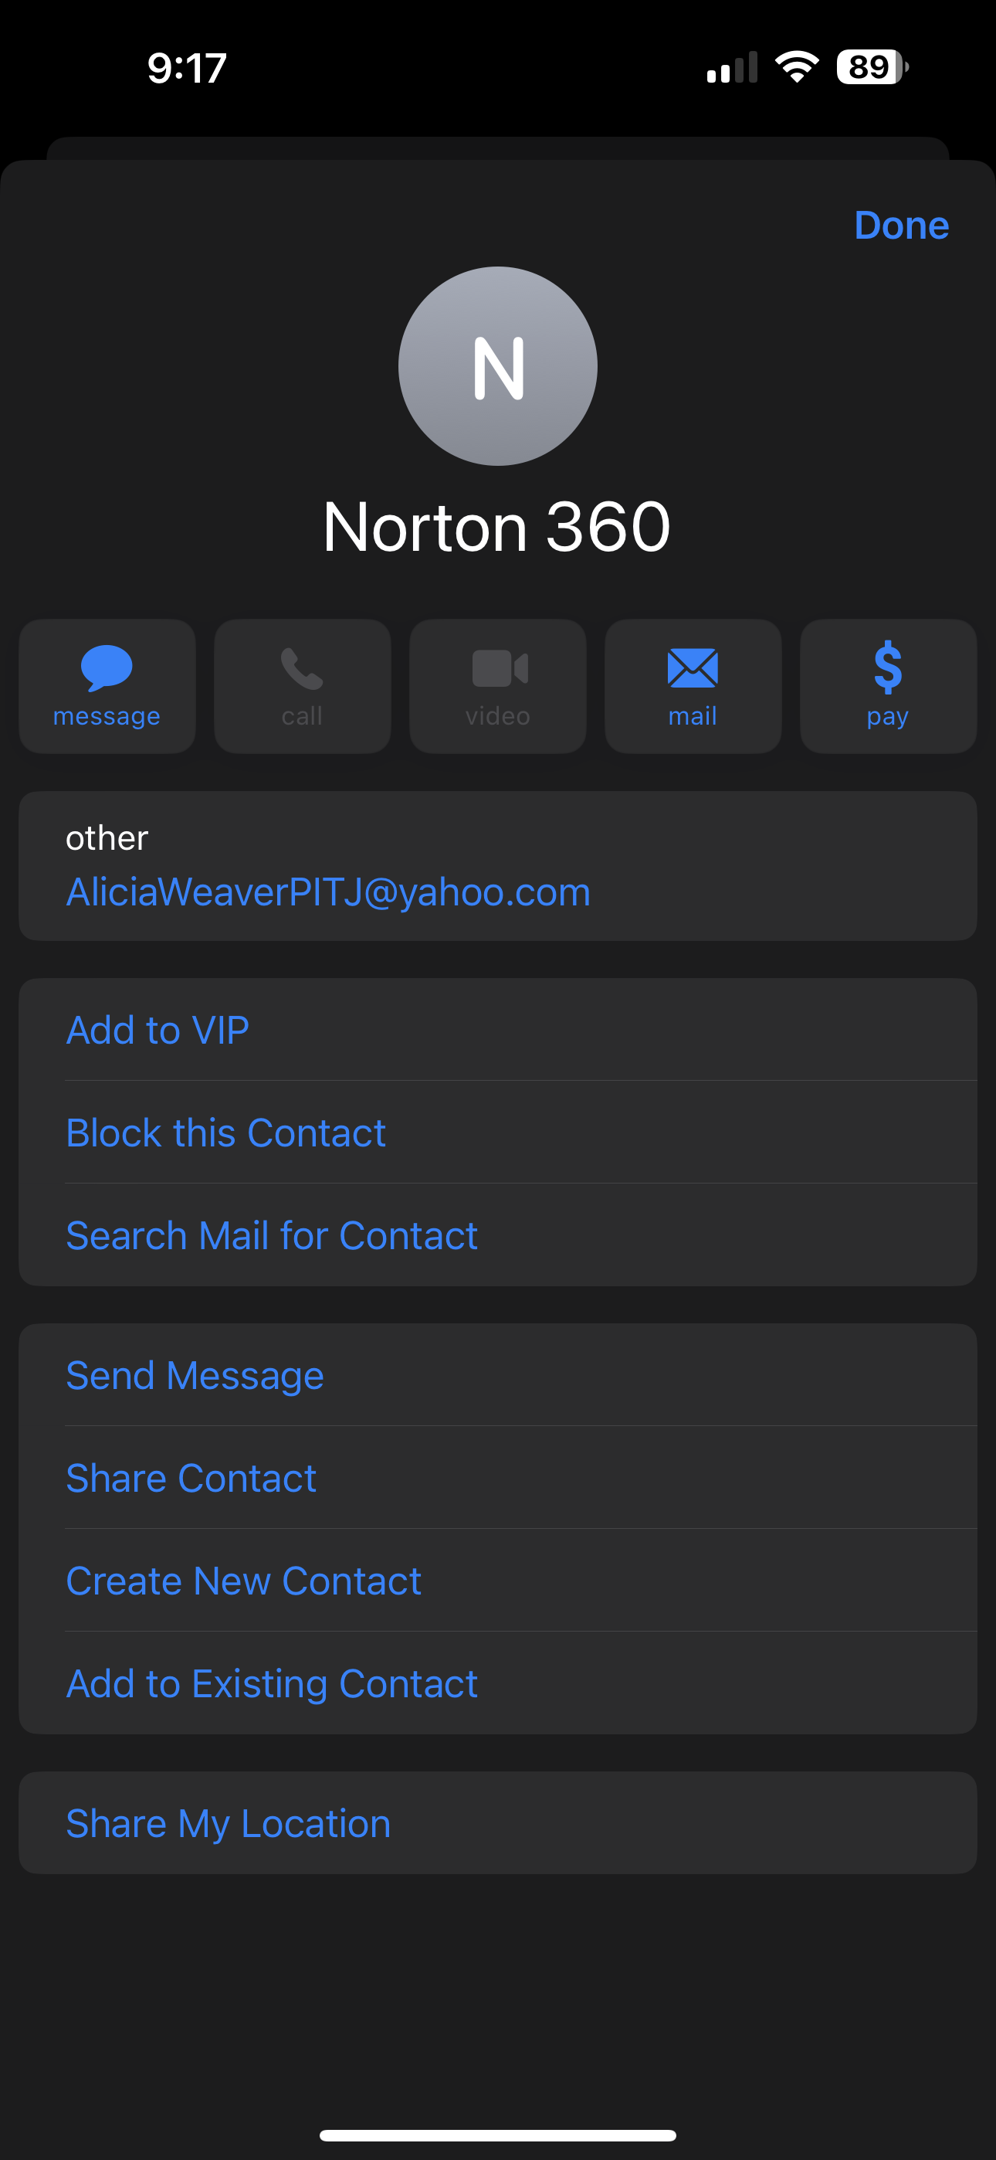
Norton LifeLock

Slide 7
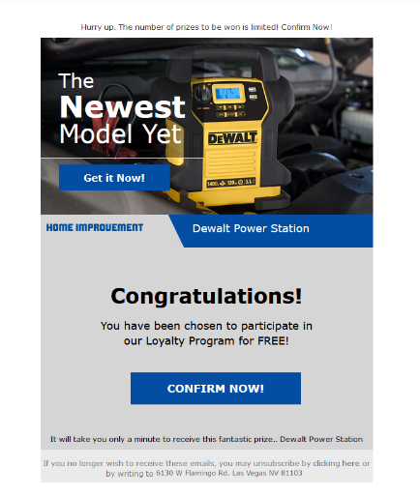

Phishing

Slide 8
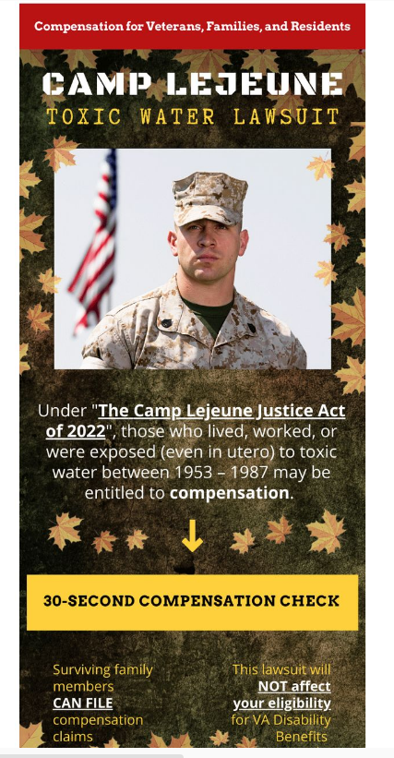
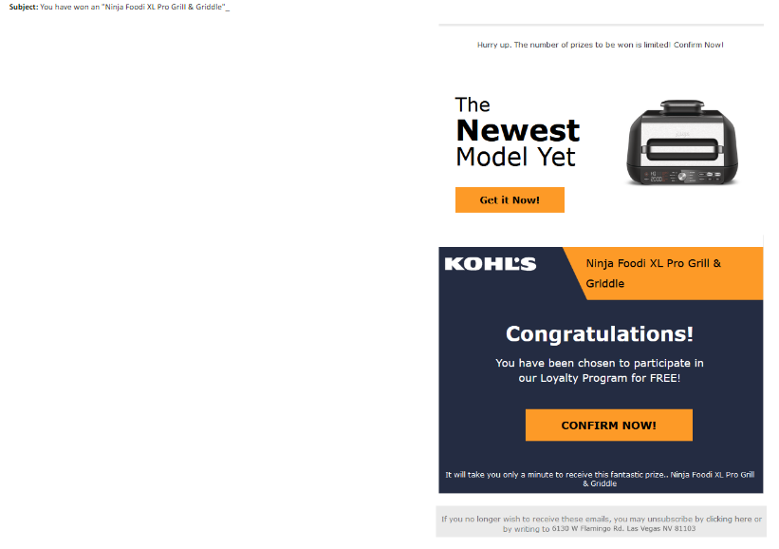
Phishing

Slide 9
Questions?

