Slide 1
Pwnagotchis and WiFi Cracking

Slide 2
Pwnagotchi
Pwnage ++ Tomagotchi == Pwnagotchi
AI Powered Wifi Cracking Device.
Cute Faces, Easy to use, fun to learn with.

Slide 3
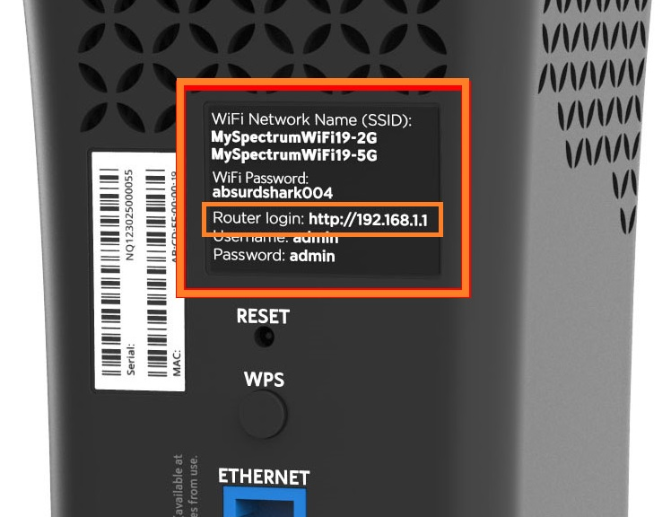
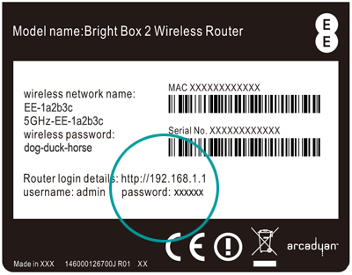
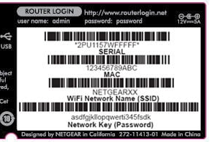
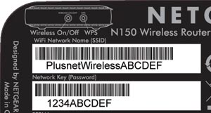
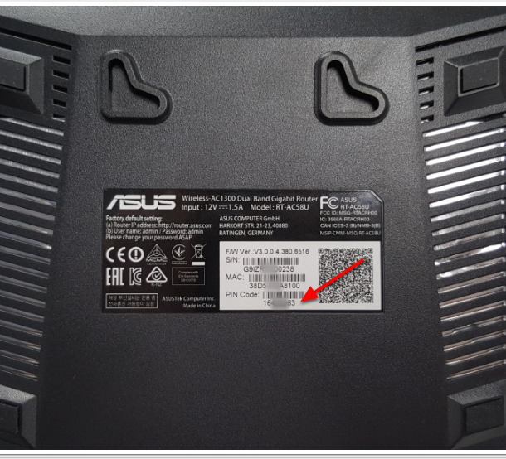
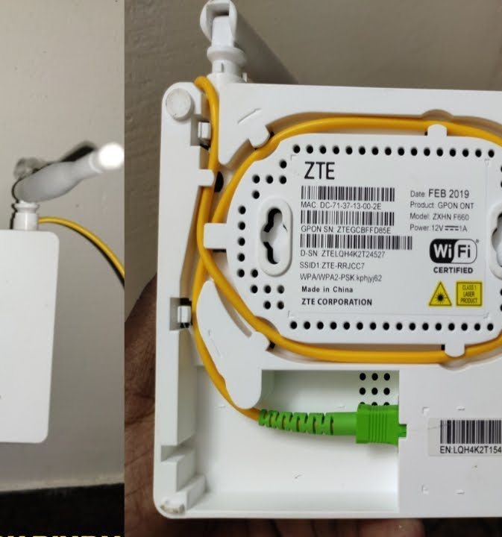
Why does it matter?
Defaults are dangerous
Most Codes are automagically generated by a piece of software before being printed on the back of the device.
https://github.com/redsquirrel7/Netgear-Password-Constructinator

Slide 4
WiFi Security Basics:
WEP – Deprecated.
RC4 Stream Cipher – Intentionally Weak due to U.S. Export Laws.
In 2001 a group of hackers used Aircrack-NG (an open source tool) to crack any WEP key in minutes due to security issues.
WPA – Common.
Uses Temporal Key Integrity Protocol to encrypt each packet with a different key—fixing the main flaw in WEP.
128 bit keys.
Built to replace WEP – Still uses some WEP features making it vulnerable.
WPA2 – Less Common but better.
Enables the use of AES-128.
WPA3 – In the works since 2018
Will be a drastic improvement as it eliminates the use of Pre-Shared Keys (PSK) and leverages the use of modern strong encryption.

Slide 5
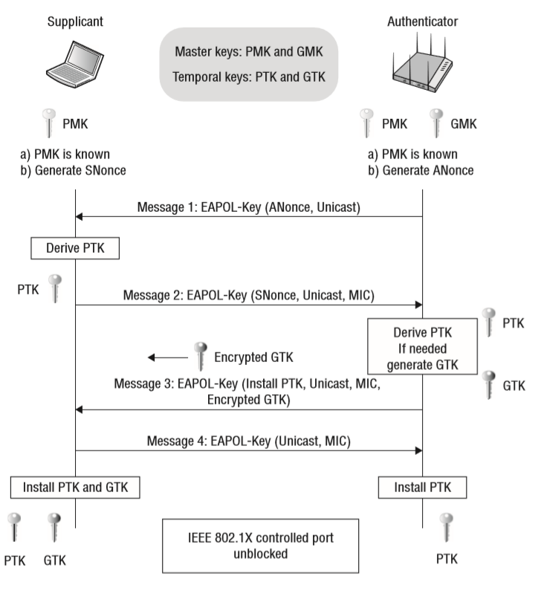
Nonce: Randomly Generated Set of Data.
MSK: Master Session Key
PMK: Pairwise Master Key
GMK: Group Master Key
Used to Generate GTK for every authenticated device.
PTK: Pairwise Transit Key
Encrypts Unicast Traffic between Client and AP.
PTK = PRF(PMK + ANonce + SNonce + MAC(AA) + MAC(SA))
GTK: Group Temporal Key.
Encrypt all Broadcast and Multicast traffic between AP and multiple client devices.
MIC: Message Integrity Check

Slide 6
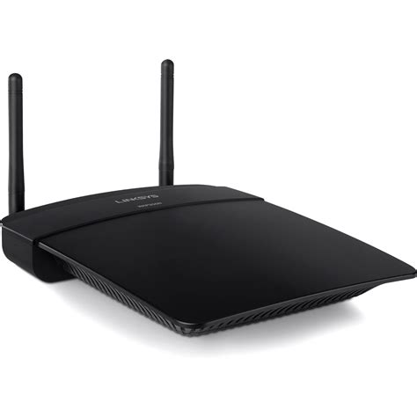
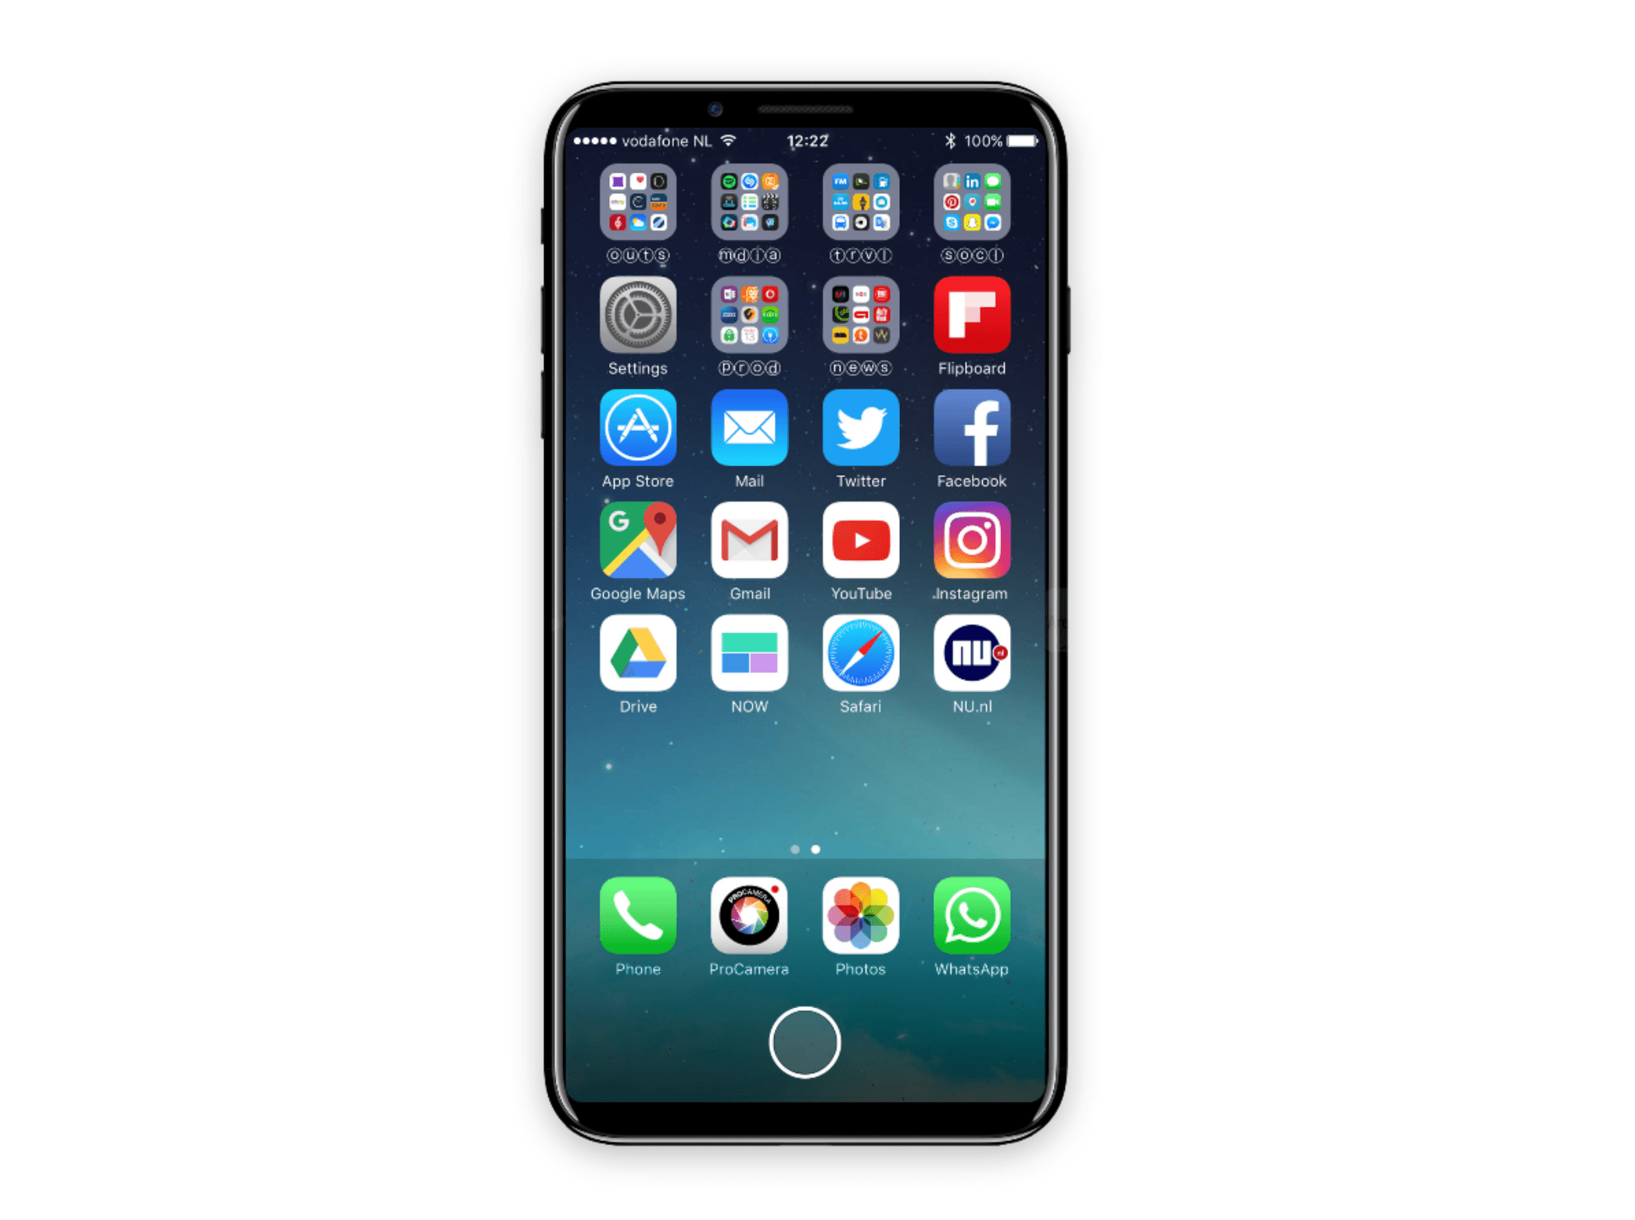
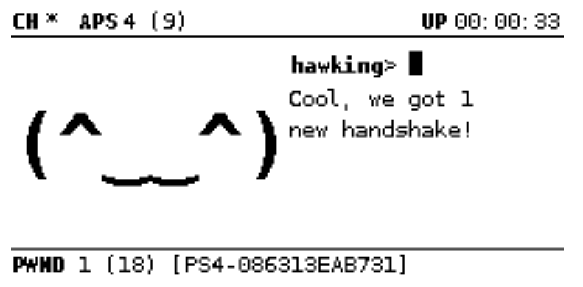
Discovery/Deauthentication
Bettercap (Bettercap.org)
WPA/WPA2 4-Way Handshake
Handshake Capture
Key Capture
Wireless Access Point
Client Device
Pwnagotchi (pwnagotchi.ai)

Slide 7
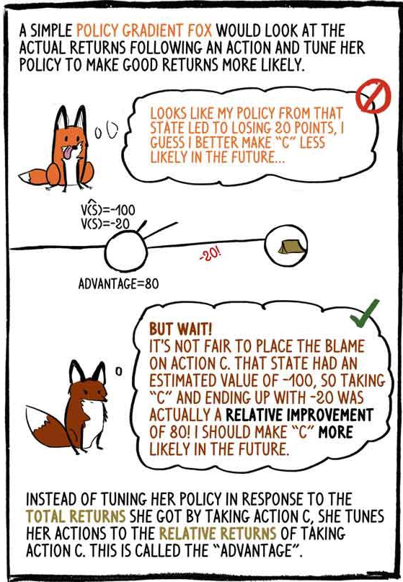
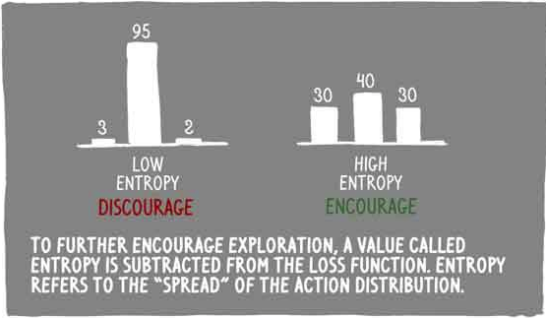
Pwnagotchi Features
A2C (Advantage Actor Critic)
https://hackernoon.com/intuitive-rl-intro-to-advantage-actor-critic-a2c-4ff545978752

Slide 8
Cracking
HASHCAT v6.0 +
Converter: https://github.com/ZerBea/hcxtools
From PCAP into HashCat Hash Version 22000
GPU Accelerated Cracking
Available on Linux, Mac and Windows.
AirCrack-ng
On Kali – Natively Can Crack PCAPS from WEP/WPA/WPA2 files.
Can also be run and installed on MacOS.

Slide 9
Resources
Build your own Pwnagotchi
https://pwnagotchi.ai/.
Learn more about Bettercap
https://www.bettercap.org/
Bettercap Attack Explanations:
https://www.evilsocket.net/2019/02/13/Pwning-WiFi-networks-with-bettercap-and-the-PMKID-client-less-attack/
GPU Cracking with Hashcat
https://hashcat.net/hashcat/
CPU / PCAP Cracking with AirCrack-NG (Quick and Dirty)
https://www.aircrack-ng.org/

